Slide 1

Deloitte Pre Hire Training
2017
FOUNDATION TRAINING
Spring MVC

Slide 2
Spring 3 MVC
Spring Controller

Slide 3
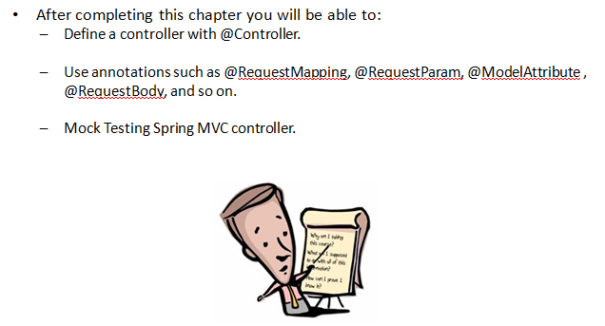
Objectives

Slide 4
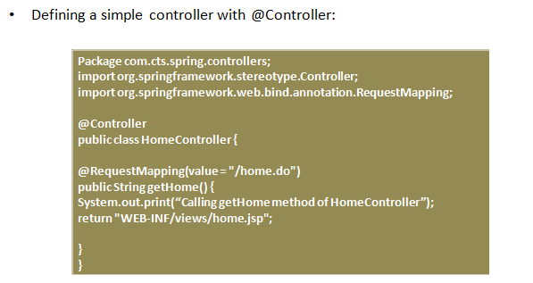
Defining Controller

Slide 5
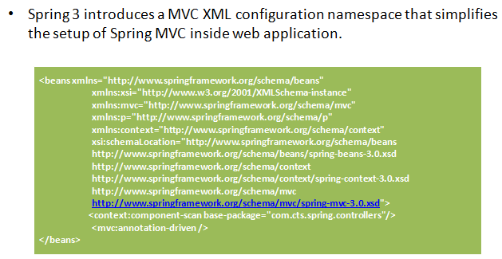
Spring 3 MVC Configuration

Slide 6
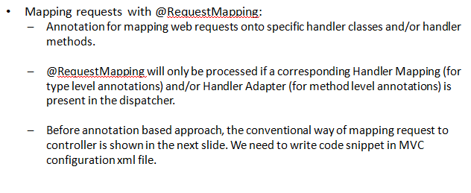
Mapping Request

Slide 7
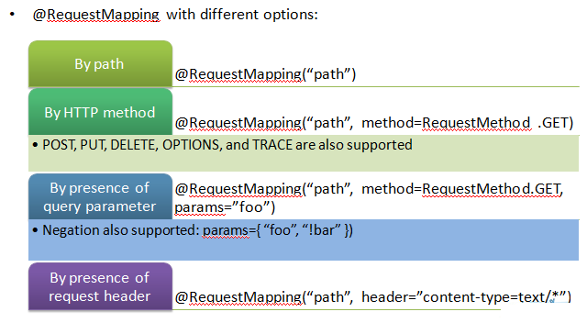
Mapping Request: Options

Slide 8
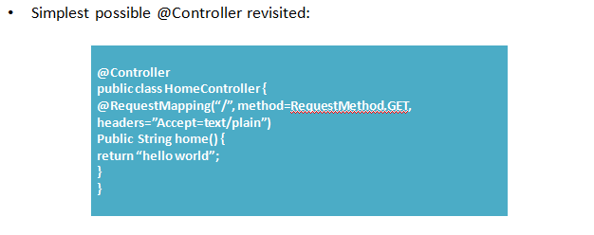
Mapping Request: Example

Slide 9
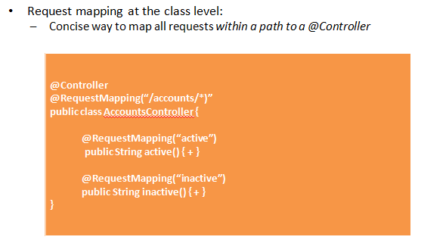
Mapping Request: Class Level

Slide 10
Hands on
Sample code to defining Controller and mapping request in the Controller.

Slide 11
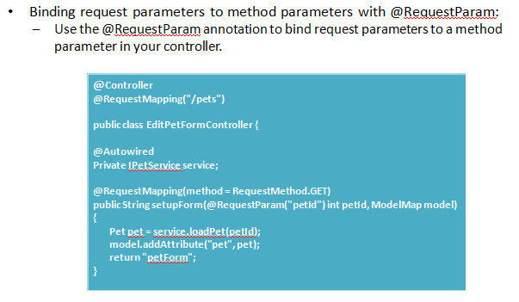
Getting Request Data: @RequestParam

Slide 12
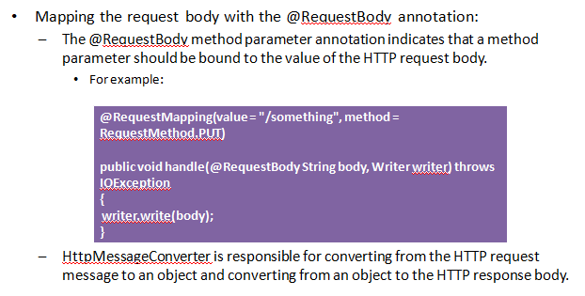
Getting Request Data: @RequestBody

Slide 13
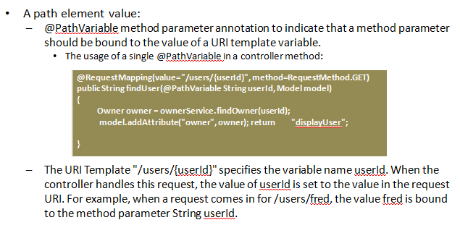
Getting Request Data: @PathVariable

Slide 14
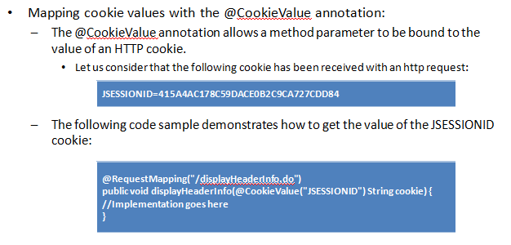
Getting Request Data: @CookieValue

Slide 15
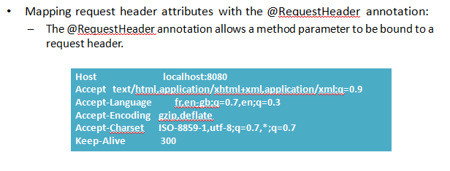
Getting Request Data: @RequestHeader

Slide 16
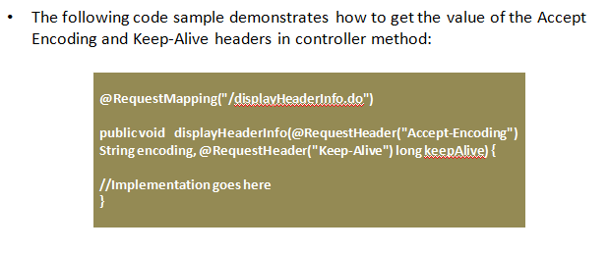
Getting Request Data: @RequestHeader

Slide 17
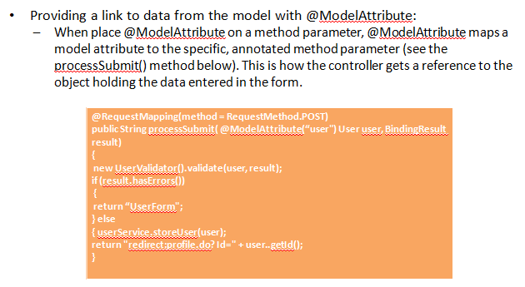
Getting Request Data: @ModelAttribute

Slide 18
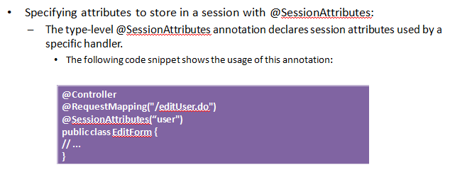
Storing Data in Session

Slide 19
Hands On
Sample code to explain all the annotations to getting data.

Slide 20
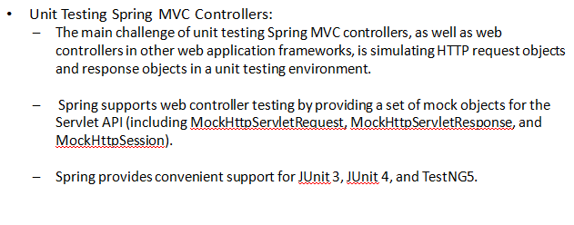
Unit Testing of Controller

Slide 21
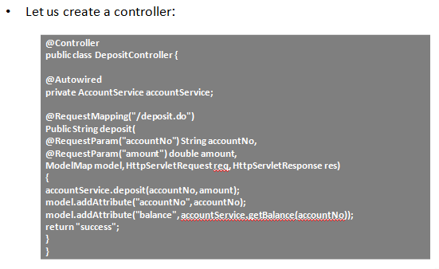
Unit Testing of Controller

Slide 22
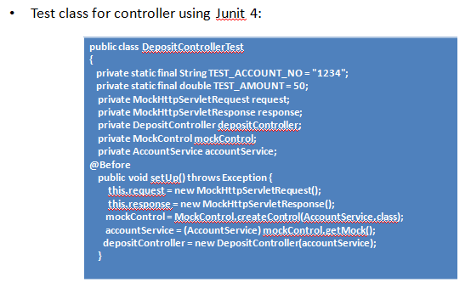
Unit Testing of Controller

Slide 23
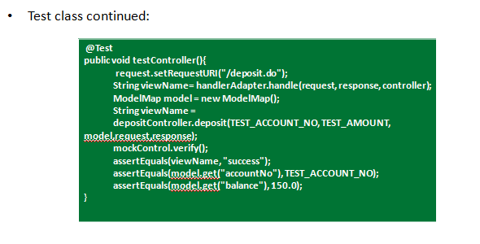
Unit Testing of Controller

Slide 24
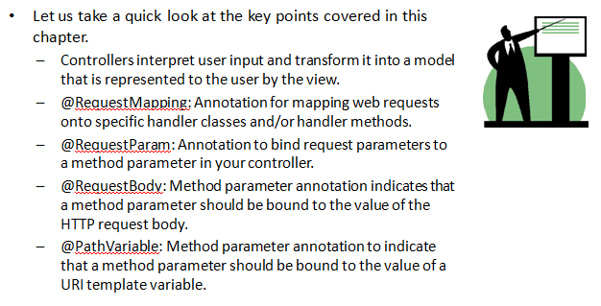
Summary

